Slide 1

Georgia Mountains Healthcare Coalition
(Region B) Quarterly Meeting
Presented by: Donna Sue Campbell and Matthew Crumpton
Date: August 21, 2019

Slide 2
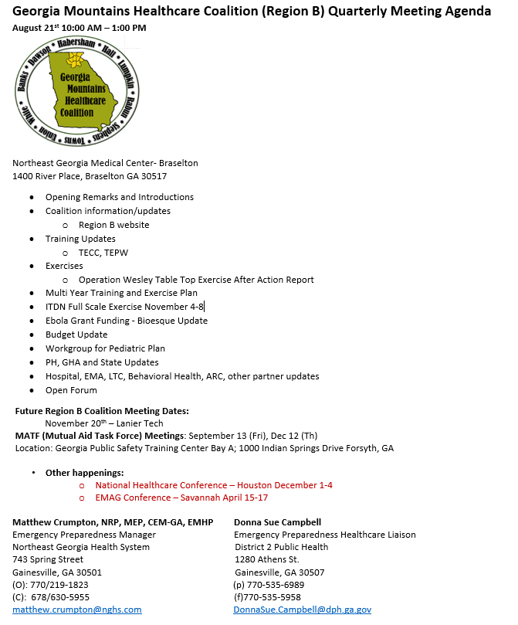
Agenda

Slide 3
NGMC and RCH Back Up
Matthew Crumpton – Coordinator
  678-630-5955
Donna Sue Campbell – Facilitator
  770-851-3089
Walker Schlundt – NGMC Back Up
  334-538-6718

Slide 4
Introductions

Slide 5

Website

Slide 6
Training Updates:
September 25-27 –Tactical Emergency Casualty Care Course - Hall County Sheriffs Training Complex
Trauma Nurse Core Class – Locations and Date?
Rural Trauma Development Course - Locations and Date?
Emergency Nurse Pediatric Care Course - Locations and Date?
CMS Long Term Care EPEP Advanced Course – February 11 – Ramsey Conference Center
February 24-26 – Tactical Emergency Casualty Care Course - Hall County Sheriffs Training Complex
Infectious Disease Conference – Mid March

Slide 7
Exercises Update
Operation Wesley TTX AAR
Infectious Disease FSE November 4-8

Slide 8
District 2 PH
  Staff notification for DOC activation
  DOC Activation
  Test redundant communications by hosting District 2 Everbridge call down drill
  Maintain situational awareness through GDPH/GEMA WebEOC monitoring
  Messaging to County Health Departments, as applicable

Slide 9
Region B HCC
Monitor resources requests from Coalition partners
Maintain situational awareness through GHA911 WebEOC monitoring
Test redundant communications via Everbridge Call down drill, possible WebEOC drill
Response partners would be at their work site
PUI arrive at Tier 3 facilities who choose to test their processes (Identify – Isolate – Inform)

Slide 10
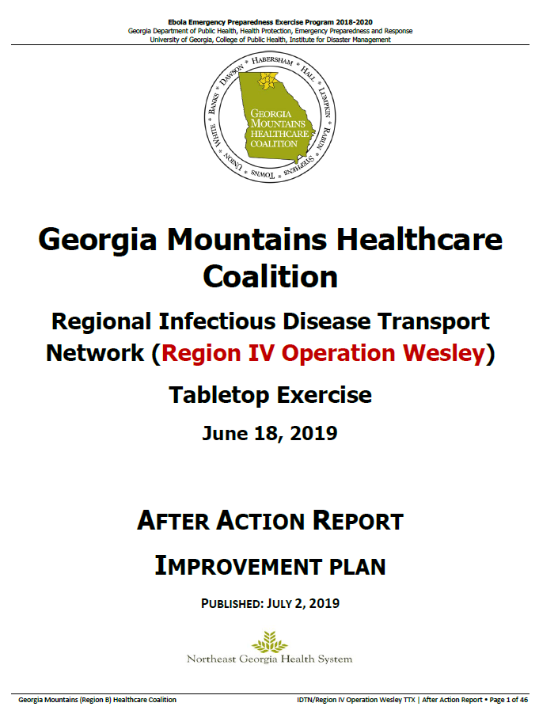
What is in the AAR?
What was the exercise?
How was it planned?
Who participated?
What did we learn?
Where do we go from here?

Slide 11
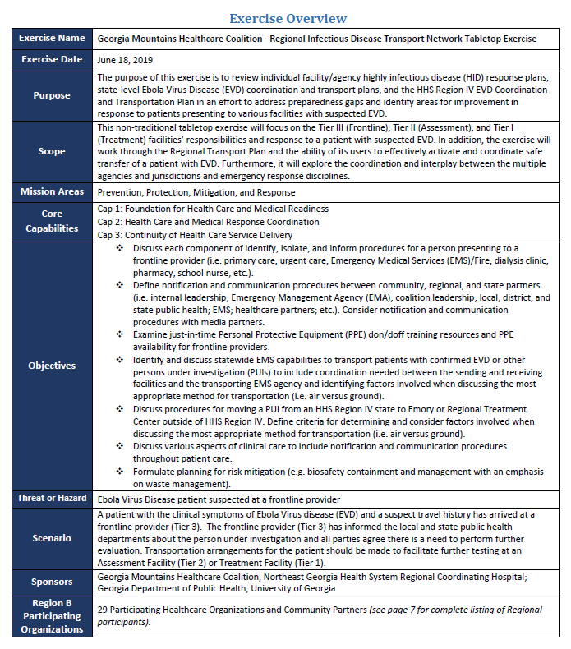
Exercise
Overview

Slide 12
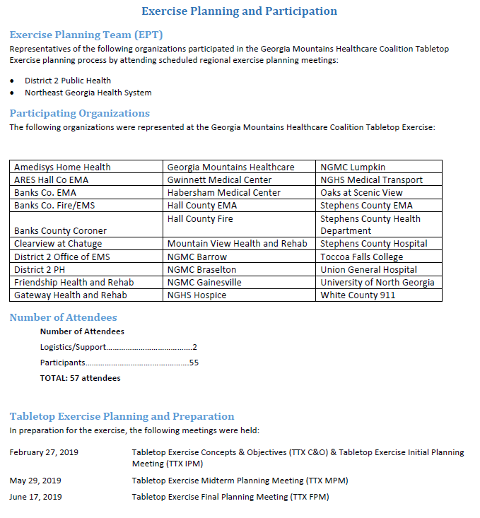
Participating Organizations

Slide 13
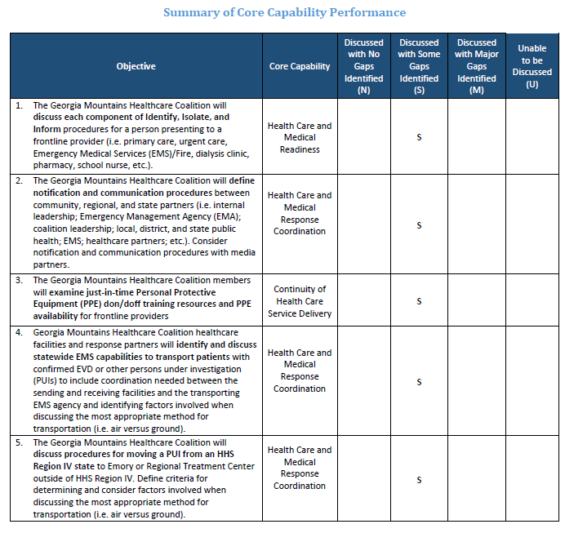
Regional Analysis of Core Capabilities

Slide 14
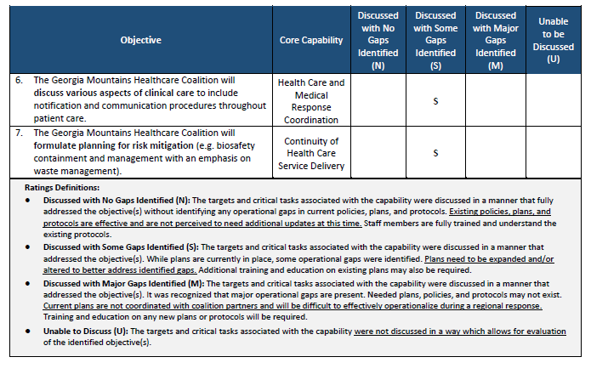
Regional Analysis of Core Capabilities

Slide 15
CORE CAPABILITY: FOUNDATION FOR HEALTH CARE AND MEDICAL READINESS
Strengths:
✓ Most frontline facilities within Coalition B are aware of and exercise identify, isolate, and inform procedures. These procedures are regularly tested and include no notice arrivals of symptomatic patients with a positive travel history and exercise calls to 1-866-PUB-HLTH.
✓ Most Region B participants have identified Highly Infectious Disease (HID) patients as a risk through conducting hazard vulnerabilities and risks assessments and are aware of regional resources available through the healthcare coalition
✓ Some participating organizations report strong confidence in their facility’s screening practices that lead to early identification of an HID patient.
Opportunities for Improvement:
• Education on Identify, Isolate, and Inform: Though many frontline facilities are familiar with identify, isolate, and inform procedures, there are a few facilities and agencies that remain unclear on their specific role as a frontline facility and how their response should look like when encountering a patient with symptoms and a positive travel history. ➢ It is recommended that education and training be conducted regarding identify, isolate, and inform procedures for all entities within the coalition. It is critical that each member of the coalition have a working knowledge of the appropriate procedures when encountering possible EVD or other special pathogen patients.
• Infection Control training for registration/intake staff: Some facilities identified areas of improvements regarding screening practices and resources for frontline staff. ➢ It is recommended that registration and intake staff be included in awareness level training for EVD and other special pathogen patients, with emphasis on travel questions and symptoms to look for.

Slide 16
CORE CAPABILITY: HEALTH CARE AND MEDICAL RESPONSE COORDINATION
Strengths:
✓ All Region B participating organizations are aware of community partners and local/regional resources available and report great strength in utilizing the Coalition’s Regional Communication Coordination Plan.
✓ Most Region B facilities have formal HID Plans that address internal and external communications, EVS procedures, and staff monitoring with an identified Person Under Investigation (PUI).
✓ Most Region B facilities are aware of the Everbridge communication platform and its usefulness in mass notification during any incident, including identification of PUI at a frontline facility.
Opportunities for Improvement:
• Education on Regional Communications Coordination Plan: Some Coalition members remain unclear on their specific roles within the Regional Communication Coordination Plan and how regional coordination is achieved in such an incident. ➢ It is recommended that education and training be conducted regarding the regional communications coordination plan. It is critical that each member of the coalition have input into the regional plan and that each organization have a working knowledge of the regional plan.
• Coordination of Healthcare Emergencies with Local EMAs: While relationships seemed strong at the local level, there may be a lack of comprehensive understanding of what should and should not be coordinated through local EMA in terms of a healthcare disaster of this nature. This would be true especially when comparing one healthcare discipline vs. another since they are at varying levels of emergency preparedness understanding or activity.

Slide 17
CORE CAPABILITY: CONTINUITY OF HEALTH CARE SERVICE DELIVERY
Strengths:
✓ Staff at most Region B facilities are abundantly trained on PPE donning/doffing procedures and special considerations regarding HID patients, with great procedural checklists that are available and visible in donning/doffing areas.
✓ Most staff are well-informed of the PPE required in contact of a potential PUI and the differences in resources for a wet versus dry patient.
Some healthcare facilities and local communities have resources caches that would be available for use during an HID incident. It is, however, recognized that most of these caches would only be able to support the initial response and that additional support from neighboring counties, the region, or the state may be required.
Opportunities for Improvement:
• Procuring Additional PPE: Most of these partners also expressed concern that supplies are not readily available and that many resources (Tyvek suits, long cuffed gloves, surgical hoods, etc.) have become backordered and usual vendors lack the needed stock.
• Coordination of PPE with Local Fire/Law Enforcement Personnel: minimal biological PPE for staff and that some of these agencies have not been included when considering additional PPE needs and responder concerns.

Slide 18
CORE CAPABILITY: HEALTH CARE AND MEDICAL RESPONSE COORDINATION
Strengths:
All Region B facilities as Tier 3 facilities are knowledgeable of the process for requesting patient transport of a HID patient after they’ve been isolated. The call to 1-866-PUB-HLTH is written in their plan, communicated to staff, and trained on.
✓ Some coalition members noted that there are extremely strong relationships between local healthcare facilities and EMS providers, as well as strong public safety/ first responder involvement in the Georgia Mountains Healthcare Coalition (Region B) exercise program. Opportunities for Improvement:
• Education on Infectious Disease Transport Network (IDTN): lack of knowledge of the actual IDTN and find it interesting as well as important in understanding the process of transporting an HID.
• Education on Ebola Virus Disease (EVD) and other HIDs: lack of knowledge of EVD and other special pathogens
• More IDTN and EVD Resources and Better Visibility: While all facilities are aware of the importance of calling 1-866-PUB-HLTH once a PUI is suspected, many facilities acknowledge that visible reminders of the HID response plan could be improved.

Slide 19
CORE CAPABILITY: HEALTH CARE AND MEDICAL RESPONSE COORDINATION
Strengths:
✓ All Region B facilities as Tier 3 facilities are knowledgeable of the process for requesting patient transport of a HID patient after they’ve been isolated. The call to 1-866-PUB-HLTH is written in their plan, communicated to staff, and trained on. Staff are aware that all direction regarding transportation coordination of an HID patient will be handled by the State, so making the call early in the Identification process is of utmost importance.
Opportunities for Improvement:
• More IDTN and EVD Resources and Better Visibility: While all facilities are aware of the importance of calling 1-866-PUB-HLTH once a PUI is suspected, many facilities acknowledge that visible reminders of the HID response plan could be improved. ➢ It is recommended that Identify, Isolate, Inform procedures instructions be highly visible in all frontline facilities, especially in registration and intake areas. Resources should be electronic and well as paper hard copies. Links to the CDC website and other internet resources can be added to Intranet home screens. An ID resource binder is helpful to keep in points of patient entry.
➢ What to include on a HID patient report to the receiving facility (Information beyond that which is included in a standard patient report)

Slide 20
CORE CAPABILITY: HEALTH CARE AND MEDICAL RESPONSE COORDINATION
Strengths:
✓ All frontline facilities in Region B have individual highly infectious disease (HID) response plans that include staffing plans and designated areas to accommodate EVD patient.
✓ Some Region B facilities have HID response plans that specifically address communication, staff monitoring, and EVS procedures while other facilities report including procedures of referring to the CDC website for specific information
✓ All Georgia Mountains Healthcare Coalition (Region B) members noted that there are multiple, redundant communications platforms through which notifications are sent and received.
✓ All Georgia Mountains Healthcare Coalition (Region B) members noted that they have extremely strong relationships with other emergency preparedness and response partners within their respective communities and throughout the region. Members of the coalition know one another by name and are comfortable interacting with each other during both planning and real-world events. The commitment of coalition members to emergency preparedness is one of the region’s greatest assets.

Slide 21
CORE CAPABILITY: HEALTH CARE AND MEDICAL RESPONSE COORDINATION
Opportunities for Improvement:
• Lack of Adequate Isolation Area specifically designed for EVD-type patient: Some participating facilities either have not identified and designated adequate isolation areas to care for a patient suspected of EVD or their designated areas for this are inadequate in some way (i.e. lack of flushable toilet or donning/doffing area).
➢ Does the area have adequate donning/doffing area?
➢ Where is the area located in relation to the nearest patient exit? (this is extremely important when coordinating patient transport)
• Augmenting Healthcare Staffing Levels: Some coalition members noted that staffing would be a primary concern during an incident of suspected PUI presence that lasts longer than anticipated due to transportation coordination.
Lack of Communication of Plan to frontline staff:
➢ Including frontline staff in plan formulation and exercising is vital in identifying gaps that can exist in HID plan.
• Public Messaging Coordination: Most coalition members agree that coordinating messages during an incident is critical and that establishing a Joint Information Center could be of use

Slide 22
CORE CAPABILITY: CONTINUITY OF HEALTH CARE SERVICE DELIVERY
Strengths:
✓ Most coalition members indicated that their respective organizations consult CDC guidelines when determining the level of PPE needed to respond to any and all infectious disease patients, including those with EVD symptoms.
✓ Most healthcare facilities have provided additional and/or refresher training to staff members that may work with an infected individual. This training includes what specific PPE is required and how to don and doff the PPE properly.
Some facilities have small PPE supply caches or stockpiles for use during an HID incident. Staff members expressed general confidence that these stockpiles would be enough to support facilities through the isolation period as Tier 3 facilities.
Opportunities for Improvement:
• Gaps in Waste Management Practices and/or Knowledge of: Some facilities are unclear if their respective HID response plan includes specific and extensive waste management measures necessary in handling biohazardous waste from an EVD patient. ➢
• HID Planning Gaps in Biosafety Containment: Some facilities were unclear on certain aspects of biosafety containment related to an EVD patient, such as handling patient remains and obtaining/ handling of lab specimens

Slide 23
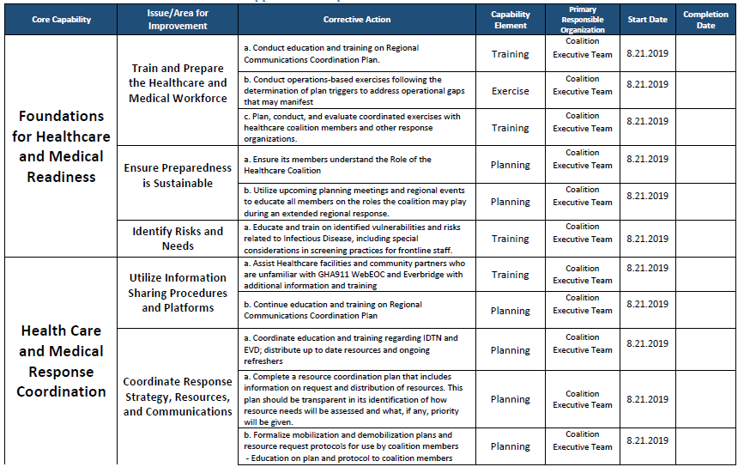
Improvement Plan Worksheet:

Slide 24
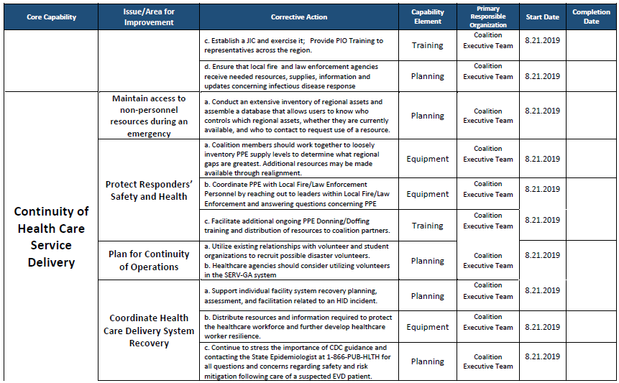
Improvement Plan Worksheet:

Slide 25
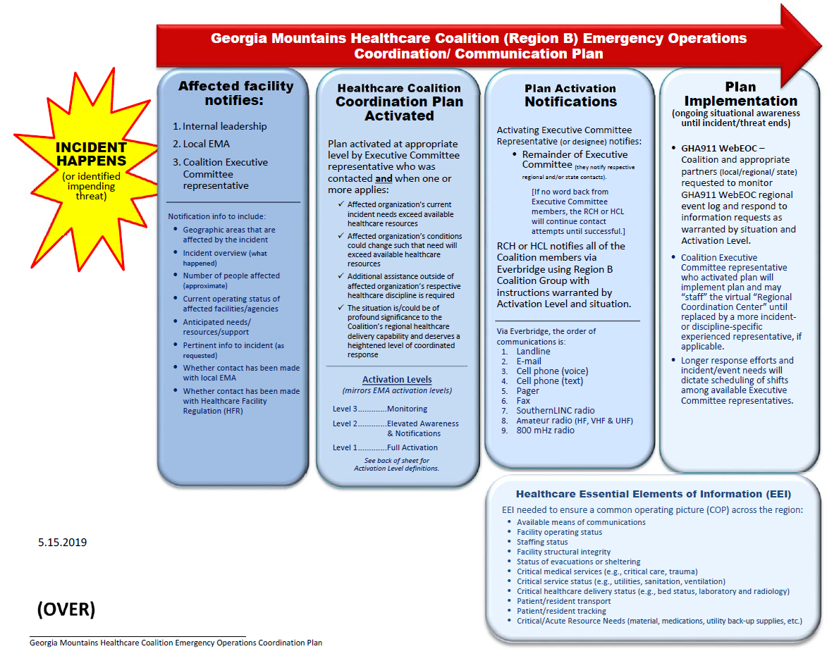

Slide 26
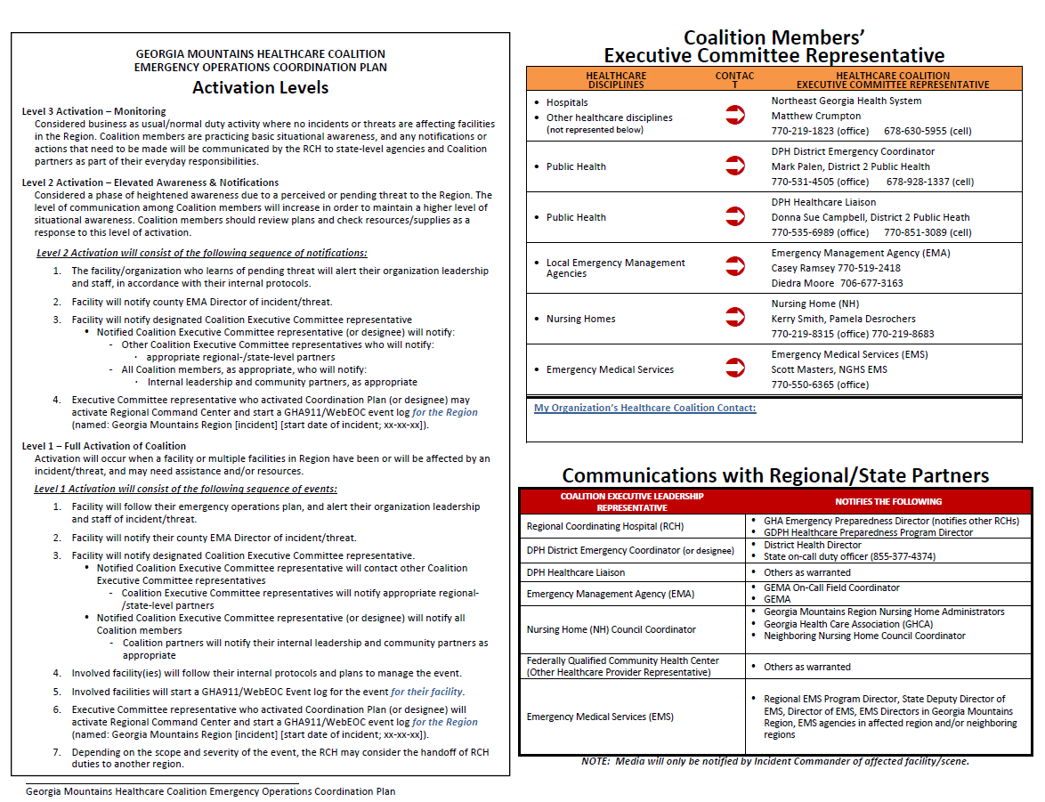

Slide 27
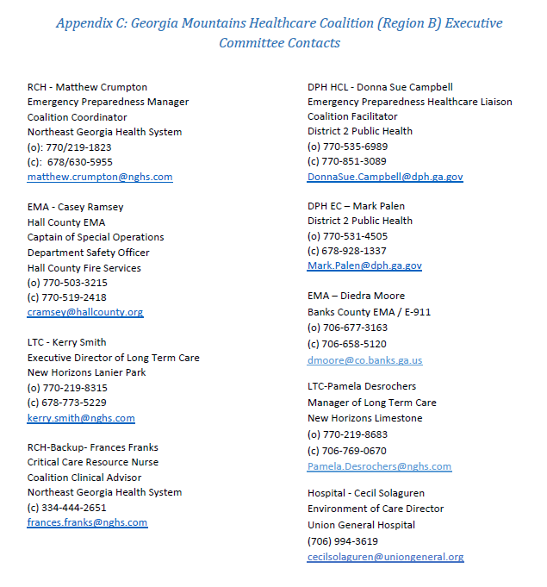

Slide 28
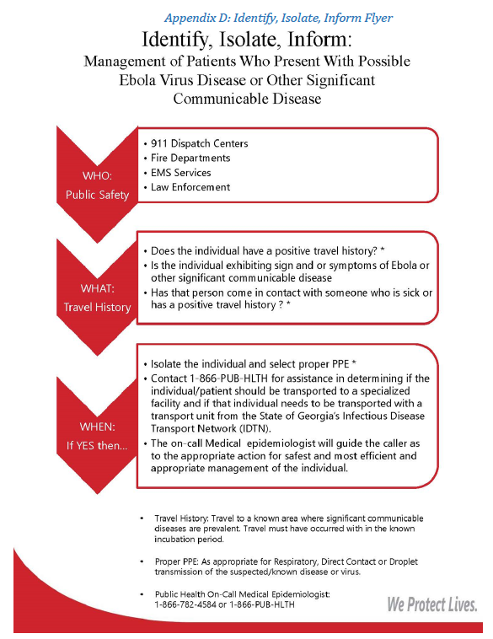

Slide 29
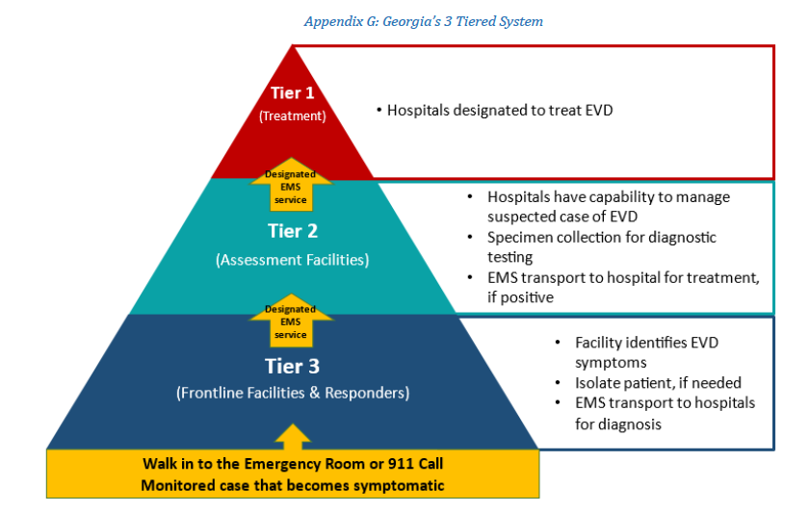

Slide 30

Accepting volunteers to be on response plan work group

Slide 31
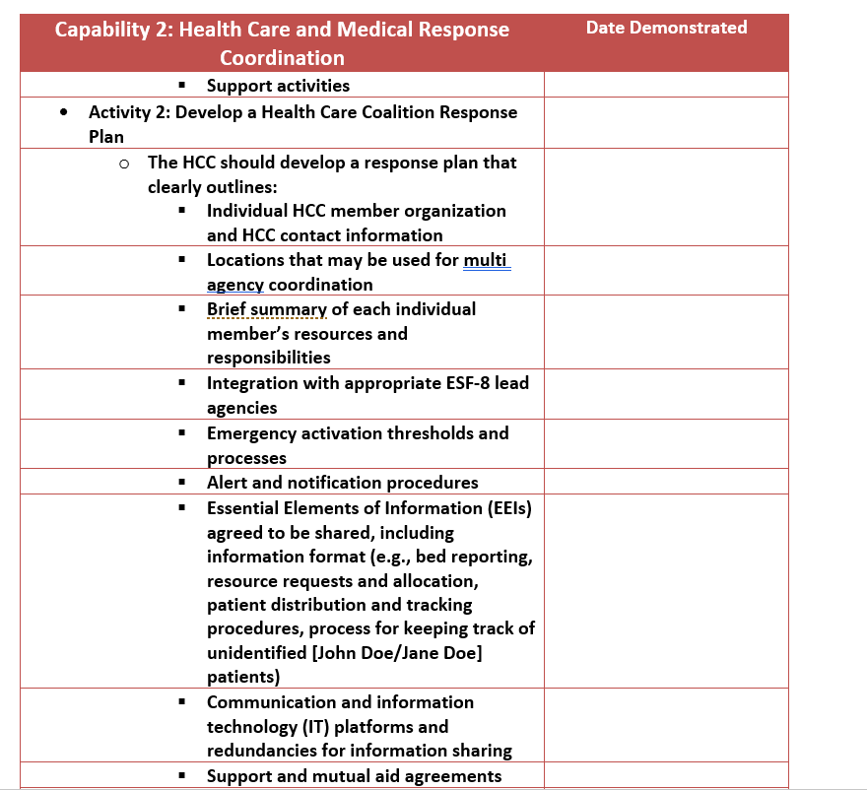
Requirements of plan

Slide 32
Multi-year Training and Exercise Plan
Region IV Infectious Disease FSE Nov 4-8
Pediatric TTX January 2019
Medical Countermeasure (SNS) FSE March 23-27, 2019
Patient Surge Full Scale late March 2019

Slide 33
Ebola Grant Funding
Updates
Grant | Amount Allocated | Amount Claimed | Amount in Process | Balance
Ebola Coalition | $180,000 | 75,008.58 | 0.00 | $107,991.42

Slide 34
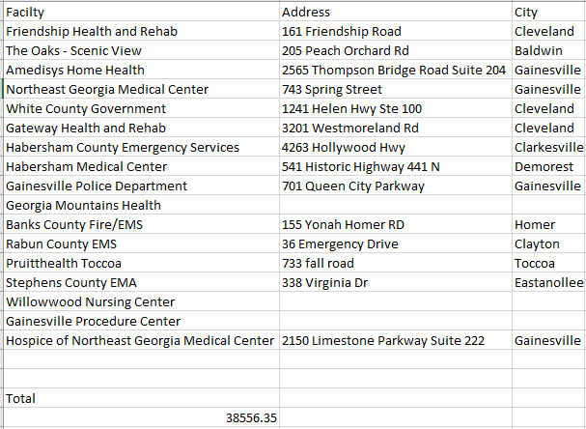
Ebola Grant Funding
Bioesque Update

Slide 35
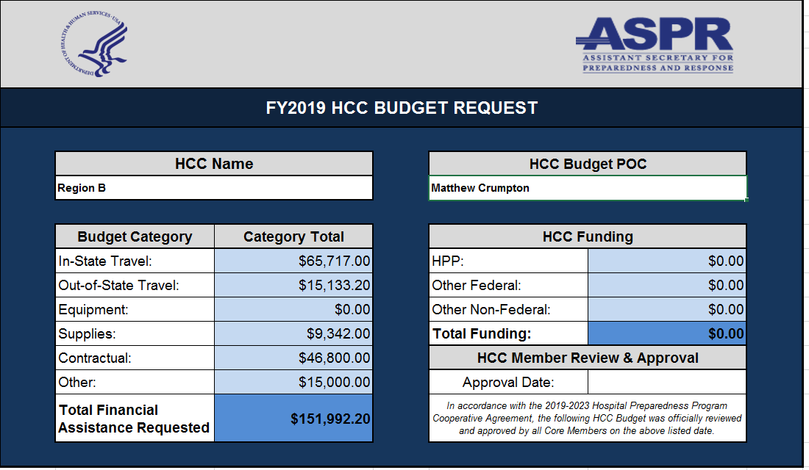
2019-2020 Budget

Slide 36
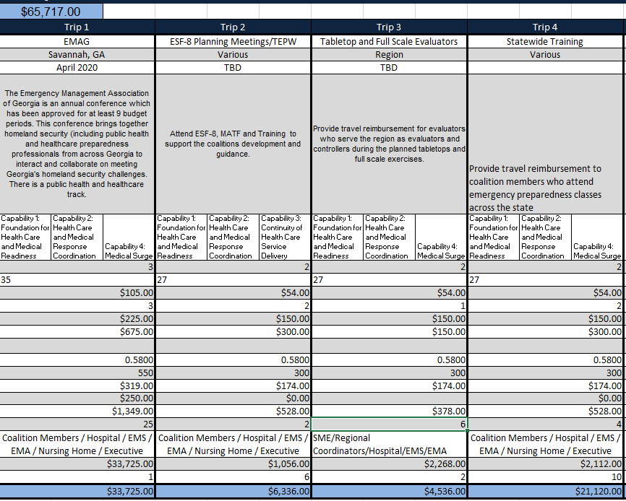
2019-2020 Budget

Slide 37
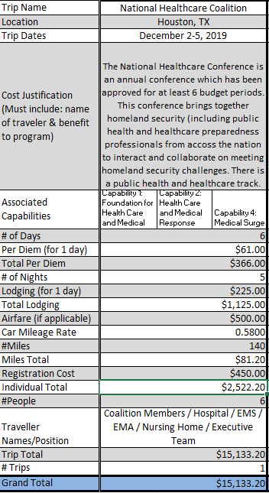
2019-2020 Budget

Slide 38
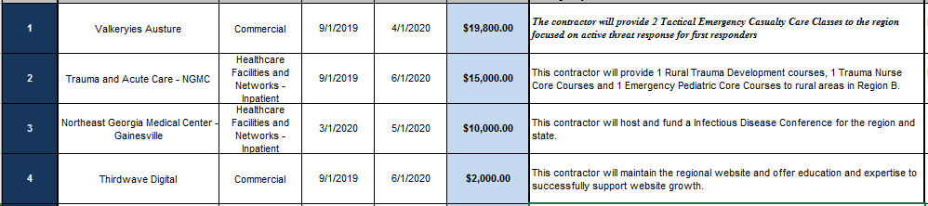
2019-2020 Budget

Slide 39
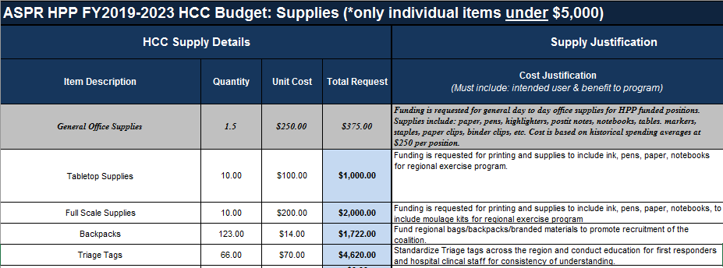
2019-2020 Budget

Slide 40
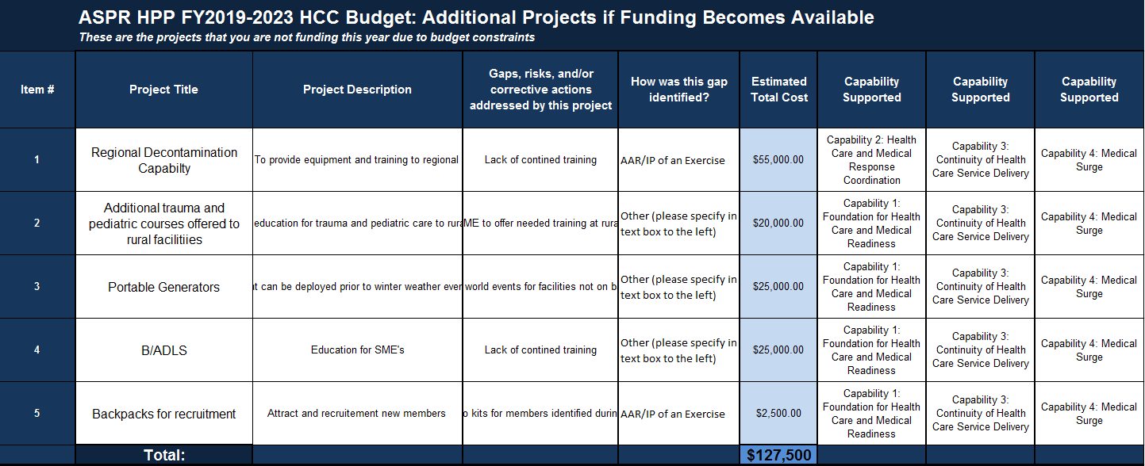
2019-2020 Budget

Slide 41
PH, GHA, and State Updates:

Slide 42
Updates from Hospitals, EMA, LTC, Behavioral Health, ARC, Other Partners

Slide 43
Meeting Wrap up
Open Forum
Future Dates
  GMHC Quarterly Meeting:
    November 20th – Lanier Tech Ramsey Conference Center
    February 19th
    May 20th
    August 19th
    November 18th
  MATF (Mutual Aid Task Force) Meeting:
    September 13th & December 12th Bay A, Georgia Public Safety Training Center
      1000 Indian Springs Drive Forsyth, GA

