Slide 1

Region B Quarterly Coalition Meeting
Darrell Townsend
Director of Emergency Preparedness and Security
Northeast Georgia Health Systems Darrell.Townsend@nghs.com
Donna Sue Campbell
Region B Healthcare Coalition Facilitator
District 2 Public Health DonnaSue.Campbell@dph.ga.gov
February 9, 2023

Slide 2
  Welcome
  Introductions
  General Updates

Slide 3

Plan Updates

Slide 4
Strategic Development and Preparedness Plan
Short term:
Continue to grow the Coalition by increasing membership and participation
Develop structure for multi-agency coordination and collaborative plan development
Ensure that all healthcare organizations, public health agencies, and emergency management organizations are included in evacuation, transportation and relocation planning and executing during exercises and real incidents.
Plan and respond together to address emergency department and inpatient surge with the goal of ensuring immediate bed availability
Demonstrate the ability to use redundant communication systems to coordinate information during emergencies, planned events, and on a regular basis (2 communications drills per year)

Slide 5
Short term goals, continued
To effectively utilize grant funding in support of filling identified gaps (i.e. training, planning, exercise and resource gaps)
Compile, maintain and update a Regional HVA
Use the Coalition Assessment Tool to self-assess progress.
Develop and Review Regional Healthcare Preparedness Plan annually
Complete the Medical Response and Surge Exercise (MRSE) and After-Action Review annually
Compile and maintain a comprehensive regional resource inventory and identify any gaps
Complete reports as requested by National HPP through the Georgia HPP.
Participate in current and future federal health care situational awareness initiatives

Slide 6
Strategic Development and Preparedness Plan
Long Term Goals:
Continue to grow the Coalition by increasing membership and participation
Continue to work toward sustainability
Coordinate with State Workgroups and other partners to develop regional plans for specified Healthcare Preparedness Program (HPP) and Public Health Emergency preparedness (PHEP) Capabilities

Slide 7
Response Plan
Response Triggers (resources are overwhelmed)
Member notification and process (Everbridge)
Maintain situational awareness (WebEOC, emails)
Monitor resource requests (WebEOC, emails)
Reporting requirements:
WebEOC updates and/or EEI

Slide 8
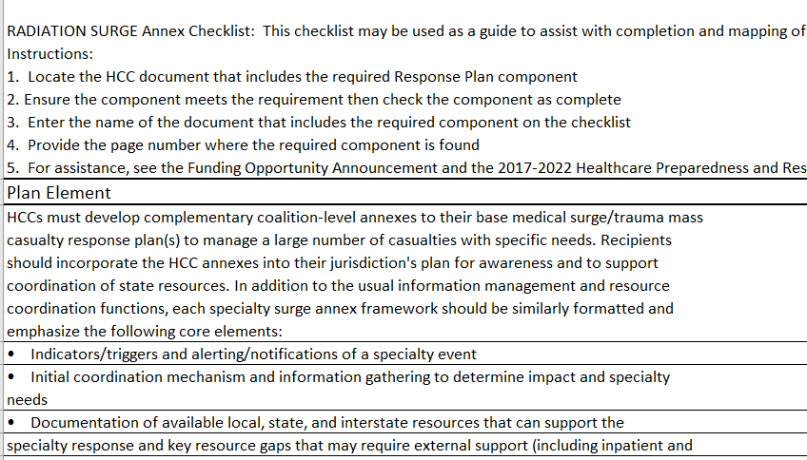
Radiation Injury Surge Plan draft due March 2023

Slide 9
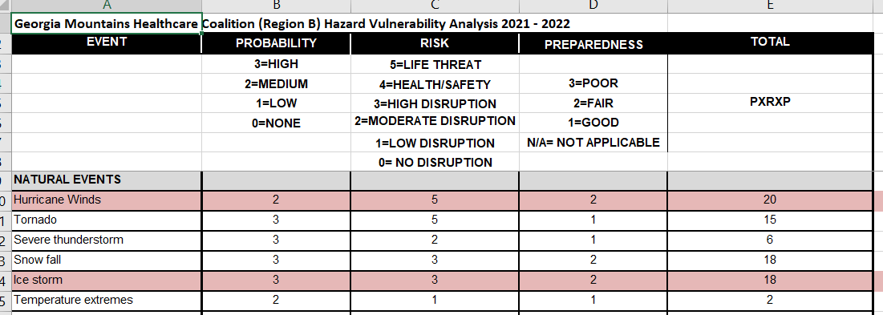
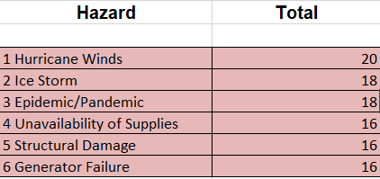
Hazard Vulnerability Assessment (HVA)

Slide 10
Training Available on GEMA TRS System – training.gema.ga.gov
Feb 27 – Emergency Operations Center/Incident Command System Interface (G191-HM) Gainesville
Feb 28 – NIMS ICS 300 – Intermediate ICS for Expanding Incidents (ICS 300 – HM) Gainesville
Mar 20 – NIMS ICS – Advanced ICS for Command and General Staff (ISC 400 – HM) Athens/Clarke Co
Mar 21 – NIMS ISC Intermediate ICS for Expanding Incidents (ICS 300 – HM) Atlanta/Fulton Co.
Mar 21 – Sports and Special Events Incident Management (MGT 404) Gainesville
Mar 28 NIMS ICS 300 – Intermediate ICS for Expanding Incidents (ICS 300 – MH) (Tucker)
Others listed:
CPR
After Action Report Development
PIO
Decision Making and Problem Solving
ARES Annual Training
Leadership and Influence
FEMA Student ID needed to register- https://cdp.dhs.gov/femasid/register

Slide 11
2022-2023 Training Budget and Progress
  Rural Trauma Development Course – SCH, Sept 22
  Pre-Hospital Trauma Life Support Course –NGHS, Oct 10
  Trauma Symposium, Oct 28
  Tactical Emergency Casualty Care, Union County, Dec 7-9
  Critical Incident Stress Management – Gainesville, Jan 9-11
  Emergency Management Agency of Georgia Emergency Preparedness Conference – Savannah, April 12-14 (sponsored attendees)
  Trauma Nurse Core Course – Gainesville, March 13-14
  Pre Hospital Trauma Life Support course, Gainesville, May 30-31

Slide 12

Region B Budget Review
  Currently in 2022 – 2023 Budget
  Grant Funds Manager is Georgia Hospital Association $152,000
  Budget focus is Radiation Injury Surge
    Radiation Injury Surge Annex required
  Submitted draft 2023 – 2024 Budget
  $152,000
    Chemical Injury Surge Annex and
    TTX required

Slide 13
Infection Control Contacts
Infection Control Contacts for Region B/Region E/District 10/District 2 – this is who you should contact if your facility is experiencing an outbreak
Sue.Bunnell@dph.ga.gov (404-967-0582)
Mary.Whitaker@dph.ga.gov (404-967-0578)
Each coalition now has an infection prevention practitioner, Region B’s (and E) is Sandy Bozarth
sandy.bozarth@nghs.com
770-219-1729

Slide 14
Speaker updates

Slide 15

Partner Updates
Updates from GHA, GDPH, Public Health District 2
Important News and “Lessons Learned” from Coalition Partners
Georgia Health Care Association
Hospitals
EMS Council
Behavioral Health
Dialysis (ESRD) Centers
Hospice providers
Home Health providers
Assisted Living facilities/Personal Care Homes
Durable Medical Equipment (DME) providers
ARES
Others

Slide 16

Questions or Feedback
Donna Sue Campbell at DonnaSue.Campbell@dph.ga.gov

Slide 17


