Slide 1

Region B Quarterly Coalition Meeting
Luke Anderson
Manager, Emergency Preparedness
Region B Healthcare Coalition Coordinator
Northeast Georgia Health Systems
Luke.Anderson@nghs.com
Donna Sue Campbell
Region B Healthcare Coalition Facilitator
District 2 Public Health
DonnaSue.Campbell@dph.ga.gov
May 11, 2023

Slide 2
  Welcome
  Introductions
  General Updates

Slide 3
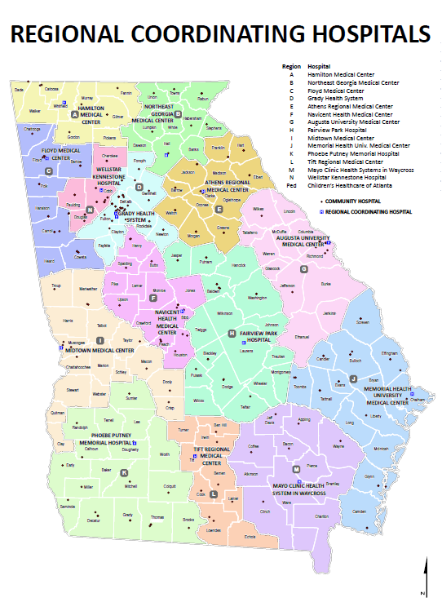
Healthcare Coalition Coordinator
Luke Anderson
Manager, Emergency Preparedness
Region B Healthcare Coalition Coordinator
Northeast Georgia Health System
743 Spring St
Gainesville, GA 30501
Luke.Anderson@nghs.com
770-219-1823 (office)

Slide 4
Clinical Advisor
Jackie Payne, BSN, RN, CEN, TCRN
Trauma Outreach & Injury Prevention Coordinator
Trauma & Acute Care Surgery
Northeast Georgia Medical Center
Jackie.payne@nghs

Slide 5

Updates

Slide 6
Training Available on GEMA TRS System – training.gema.ga.gov
May 15 - Emergency Operations Center/Incident Command System Interface (G191-HM) Rome
May 16 – NIMS ISC Intermediate ICS for Expanding Incidents (ICS 300 – HM) Rome
May 23 – Radiological Preparedness & Emergency Response (DPH – 138) Athens
May 24 – NIMS ICS 300 – Intermediate ICS for Expanding Incidents (ICS 300 – HM) Tifton
May 30 – NIMS ICS 400 – Adv ICS for Command and General Staff, Tifton
Jun 1 – NIMS ICS 400 – Adv ICS for Command and General Staff, Atlanta
June 26 – NIMS ICS 300 – Intermediate ICS for Expanding Incidents (ICS 300 – HM) Forsyth, GA
Others listed:
CPR
After Action Report Development
PIO
Decision Making and Problem Solving
ARES Annual Training
Leadership and Influence
FEMA Student ID needed to register- https://cdp.dhs.gov/femasid/register

Slide 7
2022-2023 Training
  Rural Trauma Development Course – SCH, Sept 22
  Pre-Hospital Trauma Life Support Course –NGHS, Oct 10
  Trauma Symposium, Gainesville, Oct 28
  Tactical Emergency Casualty Care, Union County, Dec 7-9
  Critical Incident Stress Management – Gainesville, Jan 9-11
  Trauma Nurse Core Course – Gainesville, March 13-14
  Emergency Management Agency of Georgia Emergency Preparedness Conference – Savannah, April 12-14 (12 sponsored attendees)
  Pre-Hospital Trauma Life Support Course, Gainesville, May 30-31

Slide 8
2023-2024 Training
Trauma Symposium, Oct 27, 2023
  (tentative) Pre-Hospital Trauma Skills Lab, Oct 26, 2023

Slide 9
Annual Site Visit
February 9, 2023 completed
Good things:
  On track with deliverables including plans
  Region B is represented at many community activities and meetings
  Sustainment options
Improvement:
  Share meeting minutes with leadership at your facility
  Continue to promote Healthcare Coalition within the community

Slide 10
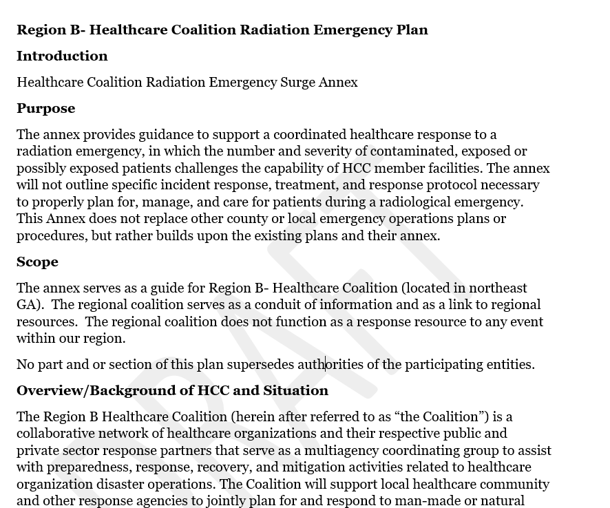
Radiation Injury Surge Plan
Draft due March 2023 completed
Final due June 2023 completed

Slide 11
Medical Response and Surge Exercise
Annual Requirement
Can be combined with another Exercise or
Real World Event

Slide 12

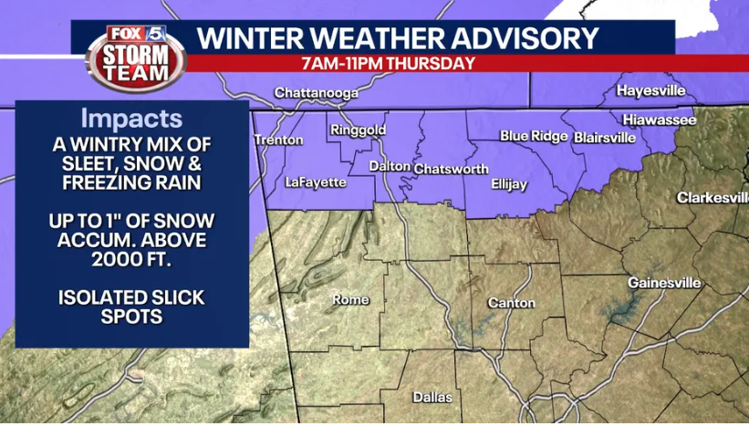
Medical Response and Surge Exercise
(MRSE) completed
Goal was to surge hospitals 20% of bed capacity in Region – approx. 225 patients
9 hospitals participating
Many calls made to community partners regarding transportation, bed availability
All patients (254) were placed in a staffed bed by the end of the MRSE

Slide 13

Region B Budget Summary
  Currently in 2022 – 2023 Budget
  Grant Funds Manager is Georgia Hospital Association $152,000
  Radiation Injury Surge Annex required
  Submitted draft 2023 – 2024 Budget
  $152,000
    Chemical Injury Surge and Radiation Surge Injury TTX in 2023-2024
  Carryover Budget 2023-2024

Slide 14
2022-2023 Budget
category | Item | Number | total
Beginning balance |  |  | $152,000
Equipment | 2 line DCON shower | 2 | $28,317
Supplies | Stop the Bleed Kits | 90 | $3783
Thirdwave Digital | Website maintenance | Annual fee | $1450
Other | Food for Meetings, trainings | TECC x3 days Ex Comm x2 CISM lunch x3 HCC x1 | $1372 $ 290 $2320 $ 956
In State Travel |  | Mileage x2 mtgs | $ 310

Slide 15
2022-2023 Budget
Beginning Balance |  | $152,000
GEMSA Educators Conference (2 people) | Oct 2022 | $ 2547
Rural Trauma Development Course – SCH | Sept 22, 2022 | $ 5000
Pre-Hospital Trauma Life Support Course –NGHS | Aug 10, 2022 | $ 5000
Trauma Symposium | Oct 28, 2022 | $ 10,000
Tactical Emergency Casualty Care, Union Co. | Dec 7 – 9, 2022 | $ 9900
Critical Incident Stress Management, Hall Co. | Jan 9-11, 2023 | $ 5500
EMAG registration | Apr 11-14, 2023 | $ 4200
EMAG travel | Apr 11-14, 2023 | $ 14,132
Trauma Nurse Core Course | May 13-14, 2023 | $ 5000
Pre-Hospital Trauma Life Support Course | May 30-31, 2023 | $ 5000

Slide 16
Carry Over Budget from 2021-2022
Beginning balance |  |  | $26,580.11
Supplies | Body Bags | White Co. EMA, Banks Co. Coroner | $ 2325.70
Supplies | DCON | NGHS | $10,193.06
Supplies | DCON | Union General | $12,488.02
Instate Travel | Travel to meetings, trainings | Mtgs x2 ESF 8 mtg | $ 138.00

Slide 17
Infection Control Contacts
Infection Control Contacts for Region B/Region E/District 10/District 2 –
this is who you should contact if your facility is experiencing an outbreak
Sue.Bunnell@dph.ga.gov (404-967-0582)
Mary.Whitaker@dph.ga.gov (404-967-0578)
Project First Line
Infection Prevention Practitioner
Region B and E
Sandy Bozarth MSN, RN, CIC
sandy.bozarth@nghs.com
770-219-1729

Slide 18
Speakers

Slide 19

Partner Updates
Important News and “Lessons Learned” from Coalition Partners
Georgia Hospital Association
Georgia Department of Public Health, District 2 Public Health
Georgia Health Care Association
Hospitals
EMS
Behavioral Health
Dialysis (ESRD) Centers
Hospice providers
Home Health providers
Assisted Living facilities/Personal Care Homes
Durable Medical Equipment (DME) providers
ARES
Others

Slide 20

Questions or Feedback
Luke.Anderson@nghs.com
DonnaSue.Campbell@dph.ga.gov

Slide 21


