Slide 1

Region B Quarterly Coalition Meeting
Darrell Townsend
Region B Healthcare Coalition Coordinator
Darrell.Townsend@nghs.com
Donna Sue Campbell
Region B Healthcare Coalition Facilitator
DonnaSue.Campbell@dph.ga.gov
November 10, , 2022

Slide 2
  Welcome
  Introductions
  General Updates

Slide 3
GHA911, WebEOC, Everbridge,
  Be sure you have access to these, if you do not, please email Mallory Garrett at mgarrett@gha.org
  Training available every Tuesday, sign up for training is on GHA911.org
HPP
Platforms

Slide 4
updates
Drills, Exercises, and Real World Events

Slide 5
Training Available
From the Disaster Readiness Line
  Project ECHO: Pediatric and Young Adult Palliative Care, Nov 16
  Project ECHO: End of Life Care/Hospice, Dec 13
  Medical Management for CBRNE Events (PER-211), Jan 10-11
  ChemLock: Introduction to Chemical Security Training, Jan 11

Slide 6
Training Available on GEMA TRS System – training.gema.ga.gov
Nov 14 – Homemade Explosives Awareness (Brasstown Valley) #100 max
Nov 15 – NIMS ICS 300 (Albany)
Nov 28 – NIMS ICS 300 (Cartersville)
Nov 29 – NIMS ICS 300 (Fayette Co. and Henry Co)
Dec 5 - NIMS ICS 400 (Monroe Co.)
Dec 6 – NIMS ICS 400 (Savannah)
Dec 7-9 – TECC (Blairsville)
Jan 9-11 – Assisting Ind/Groups
with Crisis Intervention (Gainesville)
Feb 27 – G191, prereq for 300 (Gainesville)
Feb 28 – ICS 300 (Gainesville)
Sept 6,7 – ICS 400 (Gainesviille)
Others listed:
CPR
After Action Report Development
Basic
PIO
Decision Making and Problem Solving
ARES Annual Training
FEMA Student ID needed to register- https://cdp.dhs.gov/femasid/register

Slide 7
Training continued
Georgia Long term Care Infectious Disease Education Program
  Infectious Disease Principles Course
  January 19, 2023
    Lanier Technical College
      Ramsey Conference Center

Slide 8

Radiation Injury Surge Plan Work Group

Slide 9
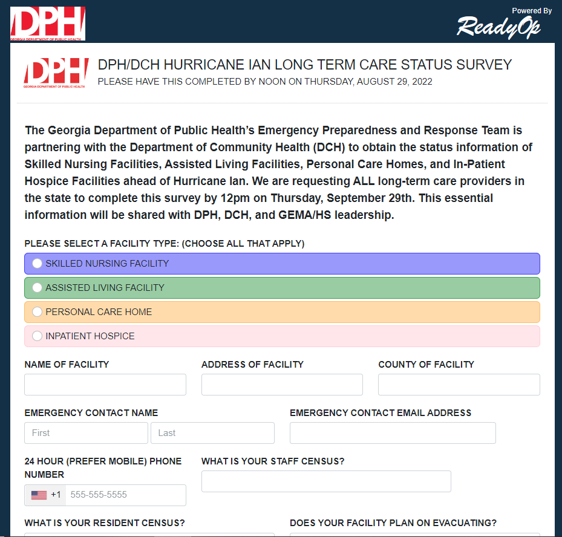
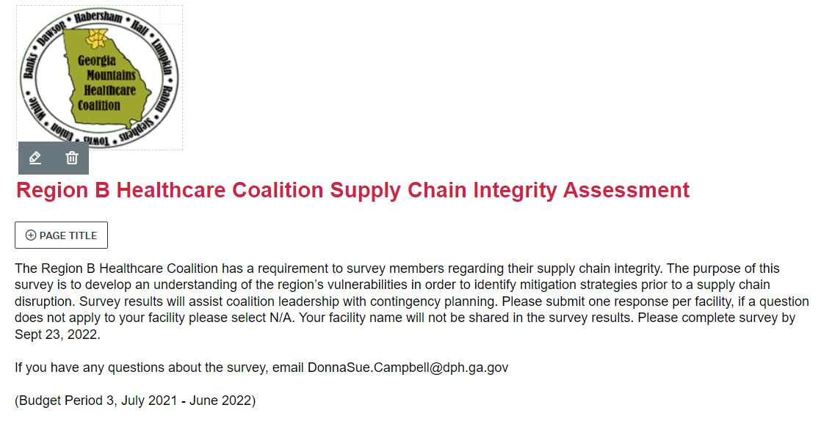
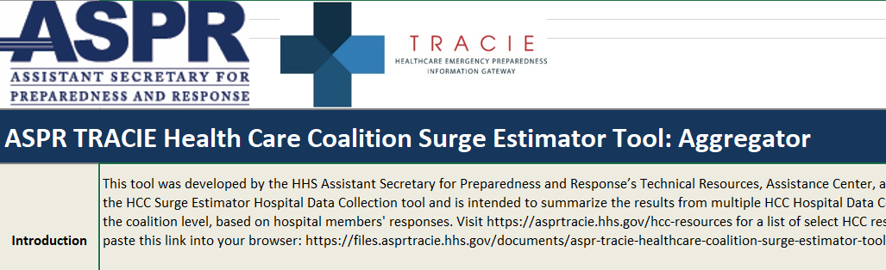
Thank you for completing surveys!

Slide 10
Infection Control Contacts
Infection Control Contacts for Region B/Region E/District 10/District 2 – this is who you should contact if your facility is experiencing an outbreak
Sue.Bunnell@dph.ga.gov (404-967-0582)
Mary.Whitaker@dph.ga.gov (404-967-0578)
Each coalition now has an infection prevention practitioner, Region B’s (and E) is Sandy Bozarth
sandy.bozarth@nghs.com
770-219-1729

Slide 11

Region B Budget Review
New FY23, BP4 budget
  Grant Funds Manager is Georgia Hospital Association instead of University of Georgioa
$152,000
Budget focus is Radiation Injury Surge
  Radiation Annex required

Slide 12
Training budget and progress
  Rural Trauma Development Course – SCH, Sept 22
  Pre-Hospital Trauma Life Support Course –NGHS, Oct 10
  Trauma Symposium, Oct 28
  Tactical Emergency Casualty Care, Union County, Dec 7-9 (on TRS)
  Emergency Management Agency of Georgia Emergency Preparedness conference – Savannah, April 12-14
  Critical Incident Stress Management – Gainesville, Jan 9-11
  Trauma Nurse Core Course – TBD

Slide 13

Questions or input
All budget input/suggestions/ideas welcome – please contact
Donna Sue Campbell at DonnaSue.Campbell@dph.ga.gov
Working on new
2023-2024 budget
Focus will be Chemical Injury Surge

Slide 14

Partner Updates
Updates from GHA, GDPH, Public Health District 2
Important News and “Lessons Learned” from Coalition Partners
Georgia Health Care Association
Hospitals
EMS Council
Behavioral Health
Dialysis (ESRD) Centers
Hospice providers
Home Health providers
Assisted Living facilities/Personal Care Homes
Durable Medical Equipment (DME) providers
ARES
Others

Slide 15


Slide 16
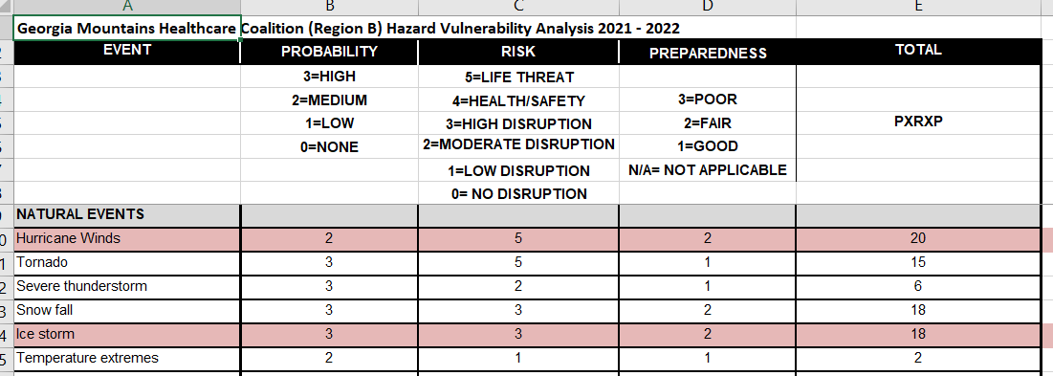
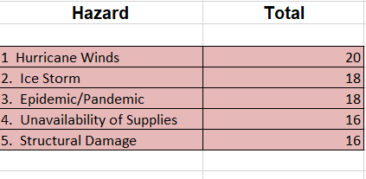
Hazard Vulnerability Assessment (HVA)

