Slide 1

Georgia Mountains Healthcare Coalition
(Region B) Quarterly Meeting
Presented by: Matthew Crumpton
Date: August 22, 2018

Slide 2
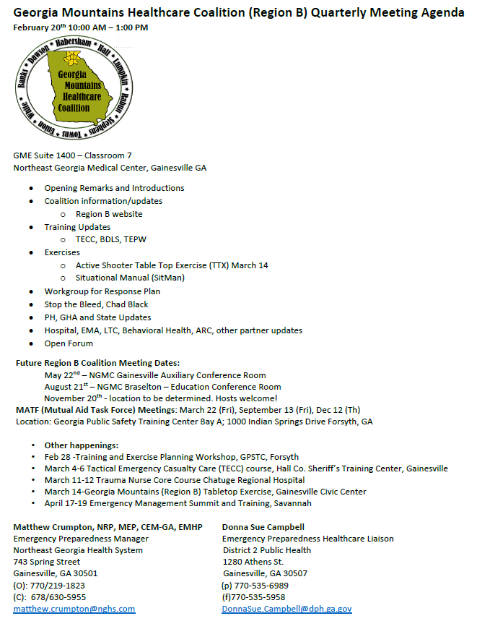
Agenda

Slide 3
Severe Weather Awareness Week 2/4
Family Preparedness/NOAA Weather Radio Day – Monday, Feb. 4
Thunderstorm Safety – Tuesday, Feb. 5
Tornado Safety drill to occur at 9 a.m. – Wednesday, Feb. 6
Lightning Safety – Thursday, Feb 7
Flood Safety – Friday, Feb 8

Slide 4

Website

Slide 5
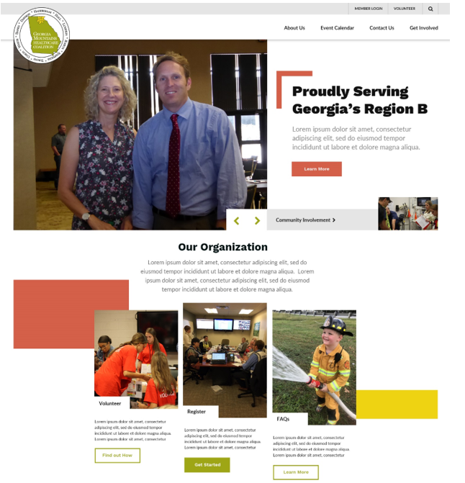

Slide 6



Slide 7


Slide 8
Coalition Information/CMS Updates

Slide 9
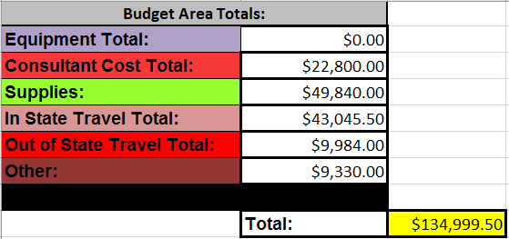
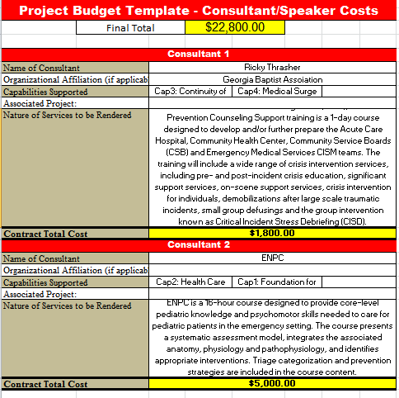
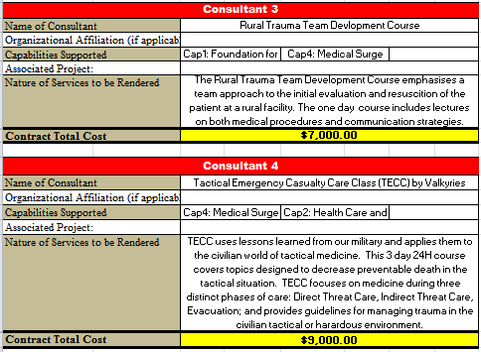
2018-2019 Budget
March 11-12
?

Slide 10
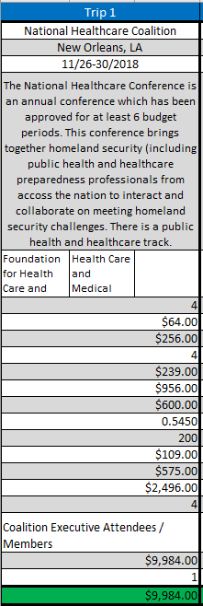
2018-2019 Budget
Out-of-State Travel
PLUS $35,000

Slide 11
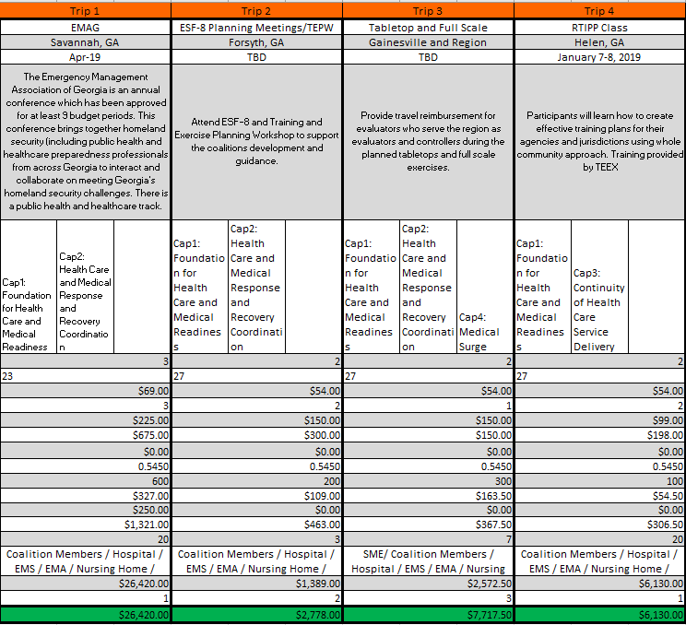
2018-2019 Budget
In-State Travel
In Progress
In Progress
Completed
In Progress

Slide 12
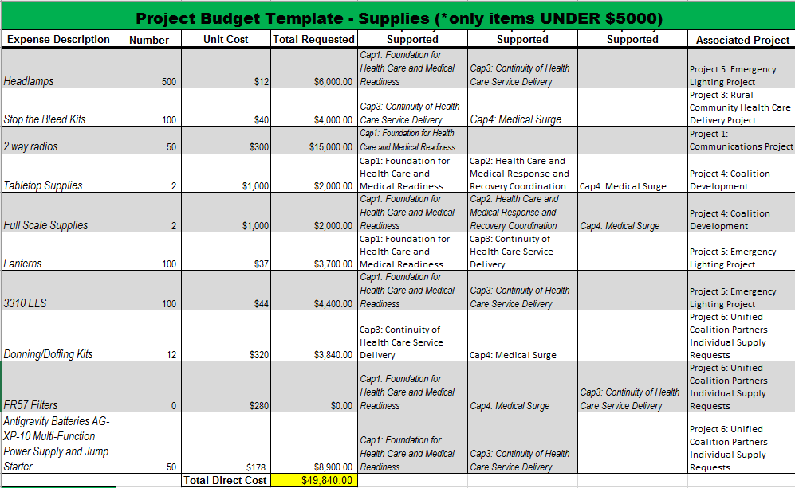
2018-2019 Budget
Completed
Completed
Completed
In Progress
Completed
Completed
Completed
Completed

Slide 13
Improvement Plan Worksheet:

Slide 14
Improvement Plan Worksheet:

Slide 15
Exercise Updates
Tabletop March 14th Lanier Technical College
  Active Shooter Tabletop Scenario in Medical Office Building
  https://www.surveymonkey.com/r/GMHCTTX19
Full Scale May 3rd – Not in Medical Scenario
BOLO: Coalition Assessment Tool
  Annual Evacuation/Surge Drill

Slide 16
Training Updates:
January 7-8 – Unicoi
  READINESS: TRAINING IDENTIFICATION AND PREPAREDNESS PLANNING MGT-418
Completed Awaiting Report
January 15th Gainesville Civic Center 830 Green Street NE, Gainesville, GA 30501
Completed 11/16 Regional Nursing Homes present

Slide 17
Training Updates:
February 28 – State Training and Exercise Workshop
March 4-6 – 2nd Tactical Emergency Casualty Care Course - Hall County Sheriffs Training Complex
  Class Full
March 11-12 – Trauma Nurse Core Class – Chatuge Regional Hospital
  5 Slots Left
Working on Rural Trauma Development Course and Emergency Nurse Pediatric Care Course

Slide 18
Training Updates:
May 31st – Basic Disaster Life Support
June 3-5 – ICS Intermediate Incident Command
June 6-7 – ICS Advanced Incident Command
Applying Incident Command to Your Healthcare Facility Response – As you request

Slide 19
PH, GHA, and State Updates:

Slide 20

GHA911.org facelift!

Slide 21
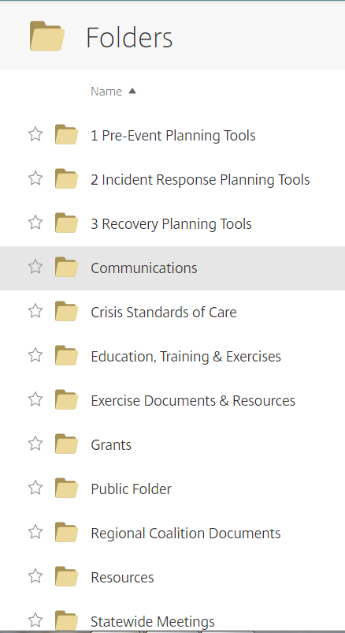
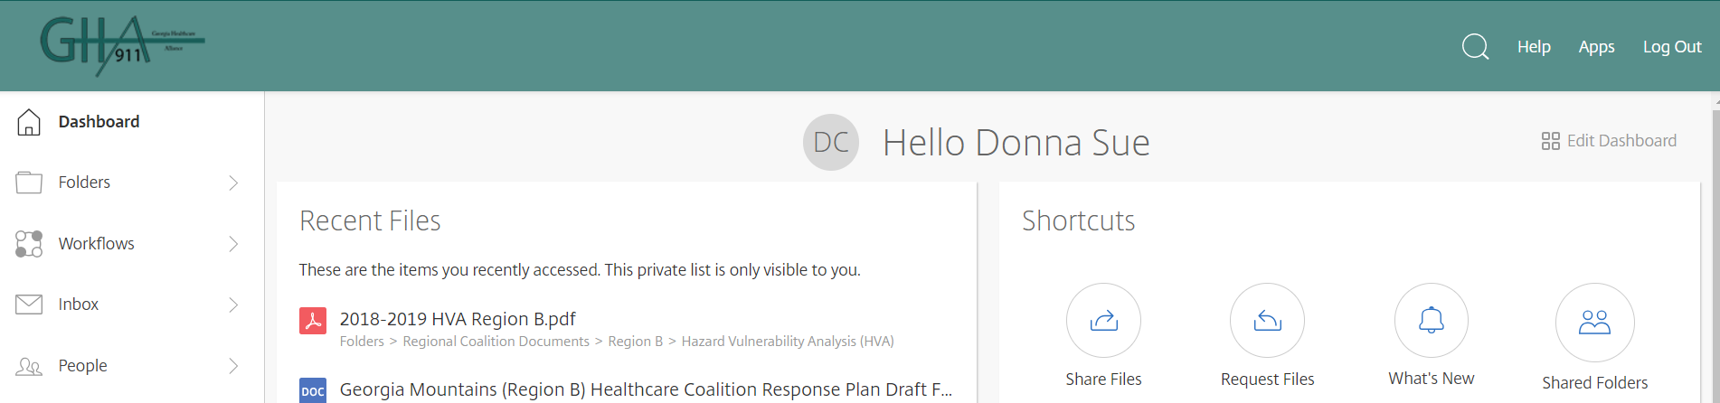
GHA911.org
File Library
Folders
Shared Folders
Regional Coalition Documents
Region B Healthcare Coalition

Slide 22
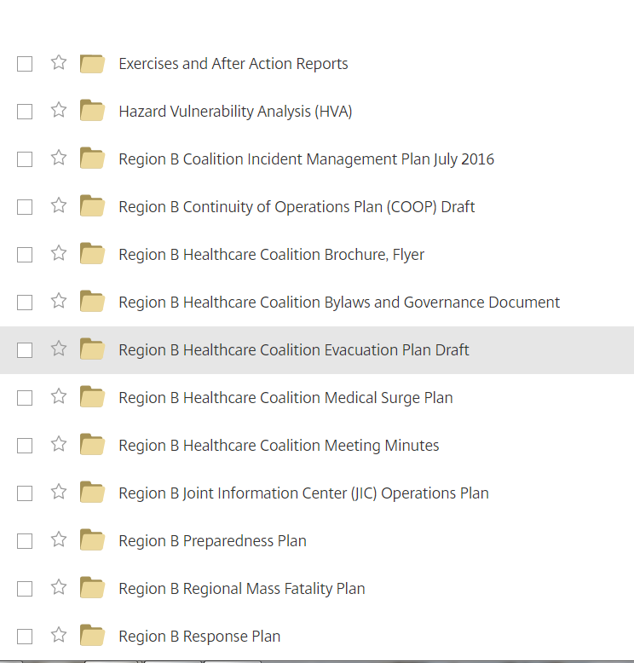
Region B File Folders

Slide 23
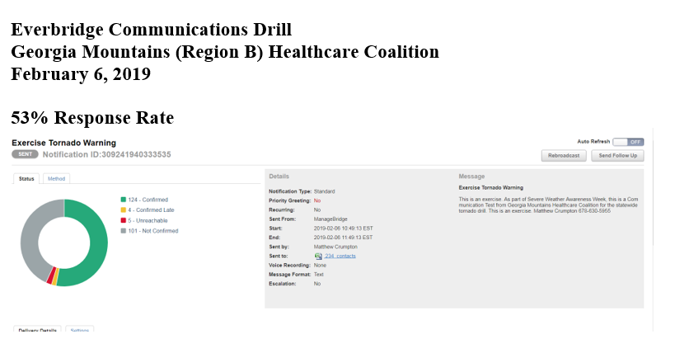
Communication Drill – Thank you for responding!

Slide 24
HVA

Slide 25
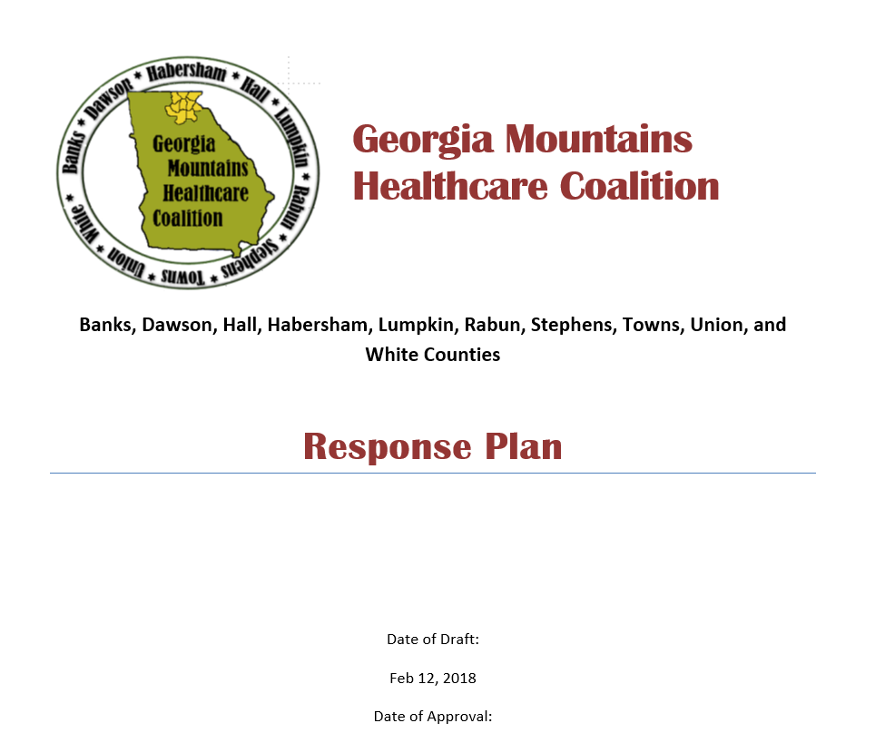
Accepting volunteers to be on response plan work group

Slide 26
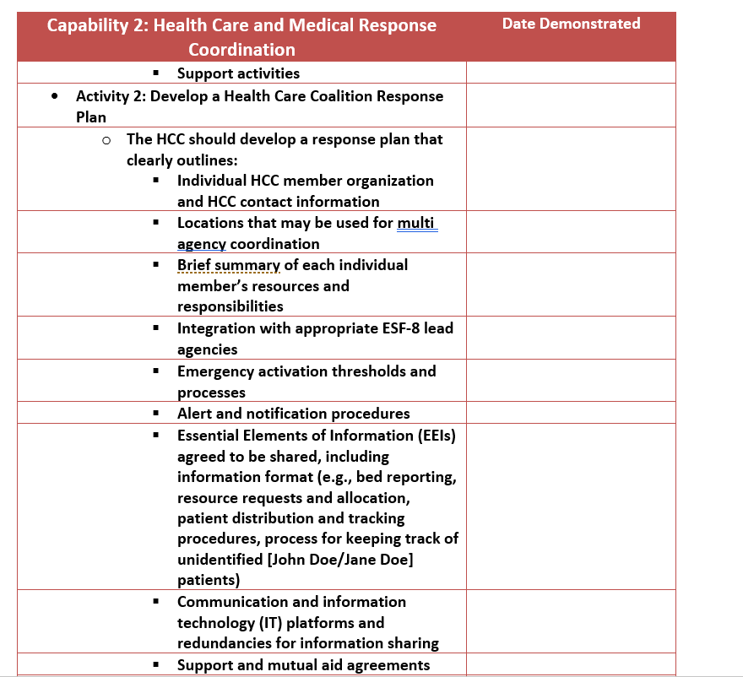
Requirements of plan

Slide 27
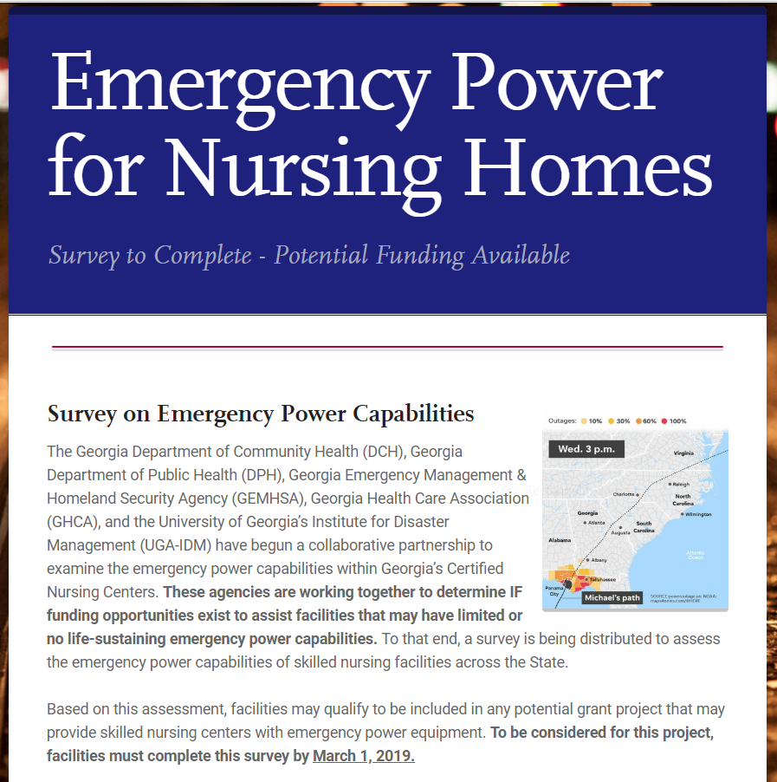
Long Term Care Alternate Power Source Survey
Please complete by March 1

Slide 28
Updates from Hospitals, EMA, LTC, Behavioral Health, ARC, Other Partners

Slide 29
Meeting Wrap up
Open Forum
Future Dates
  GMHC Tabletop :
    March 14th – Lanier Tech Gainesville
  GMHC Quarterly Meeting:
    May 22nd – NGMC Gainesville
MATF (Mutual Aid Task Force) Meeting:
    March 22nd Bay A, Georgia Public Safety Training Center
      1000 Indian Springs Drive Forsyth, GA
  Other happenings

Slide 30
2018 Winter Weather Week
December 2-8, 2018

Slide 31
Winter Storm Scenario
Wednesday, 8:00 a.m: The National Weather Service (NWS) detects a cold front moving toward ___________________. Weather officials urge citizens to prepare for a large storm that will likely begin in the next 24 hours. A winter storm warning is issued by the NWS for ___________________ as well as all surrounding areas within 100 miles. The NWS predicts light snow that will likely mix with or change to sleet or freezing rain with significant icing possible by tomorrow afternoon. Ice accumulation will likely be between 1/4 and 1/2 inch, with highest icing potential near downtown ___________________. The public is advised to expect widespread power outages, damaged trees, and treacherous road conditions because of the ice storm. Local schools are beginning to announce closures for the remainder of the week.

Slide 32
Gather Information
Key Themes:
Monitoring of weather conditions
Employee notification and communication plan
Assessing potentially affected operational components
Decision-making and decision makers

Slide 33
Winter Storm Scenario Update #1
Thursday, 8:00 a.m: Precipitation begins as wet snow for several hours, changes to freezing drizzle, and then freezing rain. Ice up to 1/2 inch thick accumulates on roads, sidewalks, trees, power lines, and houses. Wind gusts up to 40 miles per hour are reported in the area. Authorities are attempting to clear the major roadways, but the dangerous conditions make it nearly impossible to keep even the largest vehicles on the road. Nearly all roads are impassable. Emergency response vehicles are unable to respond to calls for assistance. Heavy accumulation of ice and wet snow causes dozens of trees to fall, taking down power lines. Power outages are widespread. Your school district has extended closures until Monday; all local government buildings are closed.

Slide 34
Prepare
Key Themes:
Contingency planning based on weather updates
Employee notifications and communications
Employee work status and key personnel
Protocol for early closure (Imaging centers, rehab, urgent cares, etc.)
Process for accounting for employees & visitors
Campus/grounds preparation for safety
The next 24-36 hours: decision-making and decision makers
  Essential vs non-essential staff
  Essential services vs those that can be curtailed
  Bedding of staff

Slide 35
Discussion Questions - Preparedness
What preparedness actions have you been taking to prepare for the storm?
Will an Incident Command be established at this point? What would trigger this decision?
Do you have the staff and resources available to respond 24 hours per day for the next 24-96 hours? If not, where will you look to in obtaining these resources?
What data points are you planning to monitor for Situational Awareness (SA), and how will you share your SA to develop a Common Operating Picture (COP)? What information is needed by policy- and decision-makers to ensure effective preparations are made?
What is your public information strategy at this point (i.e., what methods or means are you using to provide credible and accurate information, and what are you doing to ensure vulnerable populations are reached; do you have plans in place to use and monitor social media networks)?

Slide 36
Winter Storm Scenario Update #2
Friday, 8:00 a.m: As the day begins, 1/2 inch of ice remains underneath the snow covering. Several major roads have been cleared, but most secondary roads remain impassable. Most businesses remain closed, including many gas stations, banks, schools and daycares, and grocery stores. Many cell towers were damaged during the storm and phone service remains spotty. ___________________ is still overwhelmed; so much of the infrastructure—power lines and poles—is damaged that they estimate it may take a week or more to completely restore power to all affected areas.

Slide 37
Take Action
Key Themes:
Priorities and actions
Employee notifications and communications
Dissemination of Information
Continuity of operations; back-up systems
Property damage

Slide 38
Discussion Questions - Response
What are your response priorities, and would incident/support objectives be revised at this point?
How are you gaining SA and identifying unmet needs of the citizens within the community, and how are you sharing your SA to achieve a COP?
What entities will you be coordinating with at this point and who may be reaching out to you for assistance? How should public and media concerns and questions be handled? How can a consistent message be maintained by the Joint Information Center (JIC)?
What whole community partners might you need to include during the response?
What infrastructure systems are most at risk and which will be the most critical to restore?
  How is this decision made?
  How does fatigue factor into these calculations?
What areas of your response plan identify issues related to personal protection and discontinuing response/support/coordination operations during hazardous conditions?
  What role do policy- and decision-makers play in enforcing these guidelines?
At what point should a temporary shelter be established for residents without power?
  What resources would be needed for a shelter?

Slide 39
Winter Storm Scenario Update #3
Saturday, 8:00 a.m: Across the area, ice and snow are beginning to melt. Temperatures have remained in the 40s for the past several days. Utility crews from across the country are working around the clock to restore electricity to the area but there was so much damage, they estimate it could take an additional week or more to fully restore power. Many schools remain closed and many streets are still littered with debris.

Slide 40
Recover
Key Themes:
Continuity of Operations
Employee communications
Employee work status
Vital business documents
Community support

