Slide 2
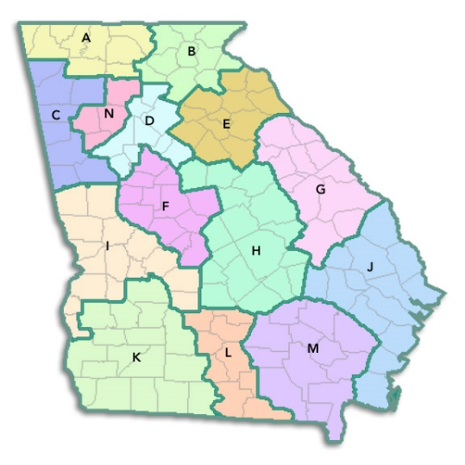
Project Firstline
Each Regional Coalition has identified an Infection Prevention and Control Education Expert. This person will work with the coalition leaders and facilitators to carry out the work of the project which includes:
Assess learning needs
Promote the IPC Educational tools on the CDC Project Firstline website
Increase the number of healthcare providers who are certified in infection control (CIC)

Slide 3
Educational Opportunities
Monthly educational flier
Weekly CIC Study Group
Site visits (contact me if you are interested)

Slide 4
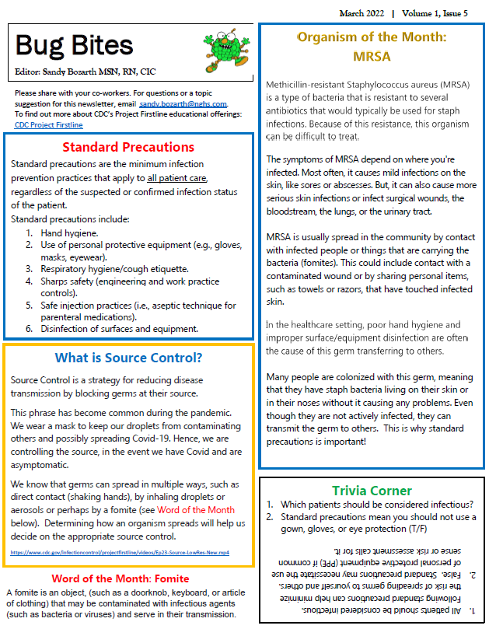
Monthly Educational Newsletter: One page education sheet for huddle boards or staff meetings

Slide 5

Weekly Study Group
Region B and E
Anyone working in the role of Infection Prevention is welcome!
Study questions are sent out weekly with a 30 minute virtual class on Thursdays during lunch.
Let me know if you know someone that would like to join us!

Slide 6
Monkeypox
Monkeypox is a disease that is caused by infection with the monkeypox virus.
This virus can spread to anyone through close, personal, often skin-to-skin contact including:
  Direct contact with monkeypox rash, sores, or scabs
  Contact with objects, fabrics (clothing, bedding, or towels), and surfaces that have been used by someone with monkeypox
  Through respiratory droplets or oral fluids from a person with monkeypox
Symptoms: This illness includes a characteristic rash and often flu-like symptoms including fever, malaise, lymphadenopathy, headache, and muscle aches.
Contagious Timeframe: A person is considered infections from the onset of symptoms and remains infectious until lesions have crusted and a fresh layer of health skin has formed underneath.

Slide 7
Monkeypox - Infection Control Guidelines
Isolation Requirements: Airborne (N95 mask), Contact (gloves and gown), Droplet (eye protection) Isolation is required. Place patient in a private room. The door should be kept closed (if safe to do so). Negative-pressure room is not necessary.
Hand Hygiene: After all contact with an infected patient and/or their environment. Hand sanitizer is approved.
Visitors: Visitors should be limited to those essential for the patient’s care and wellbeing (e.g., parents of a child).

Slide 8
Monkeypox - Additional Infection Control Guidelines
Environmental Cleaning: Clean environmental surfaces in the patient care environment with any EPA-registered hospital disinfectant.
Trash Handling: Trash should be handled with care to avoid contact with lesion material and limit dispersal of infectious particles. Place trash in a red bag, then tie securely.
Linen Handling: Should be handled with care to avoid contact with lesion material and limit dispersal of infectious particles. Place all used lined in a red bag, tied securely, then place the red bag in a laundry bag. Tie securely.

Slide 9
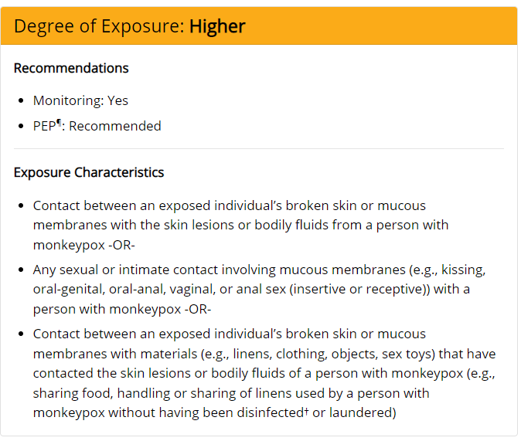
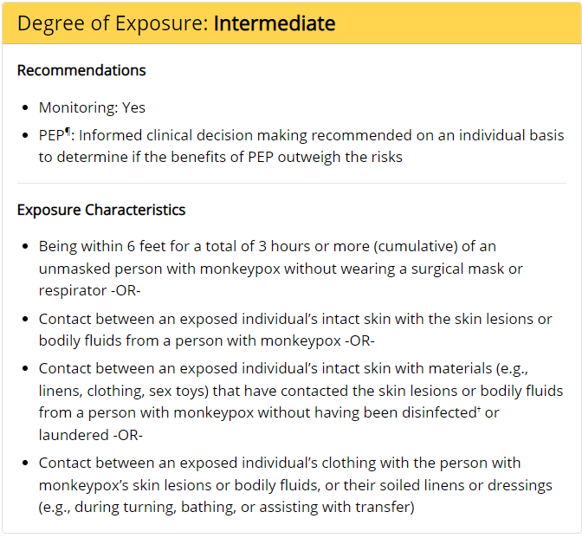
Degree of Exposure: Healthcare Settings
The CDC has posted exposure risk assessment to help determine degree of exposure and recommended actions. At this time, the levels are High, Intermediate, low and no risk.
Updates are expected soon that would move situations where providers are wearing appropriate PPE out of the low/uncertain risk category.
https://www.cdc.gov/poxvirus/monkeypox/clinicians/monitoring.html

Slide 10
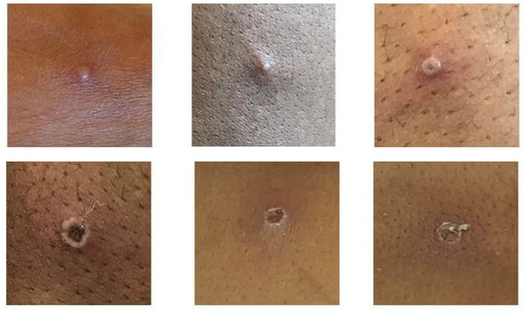
Do You Have A Plan?
What if a patient with a suspicious rash showed up at your facility?
Would your staff know:
  how to identify possible cases?
  what isolation is needed to prevent exposures?
  who to contact if the case is confirmed?

Slide 11
My Contact Info:
  Sandy Bozarth
  sandy.bozarth@nghs.com
  770-219-1729

